Slide 1
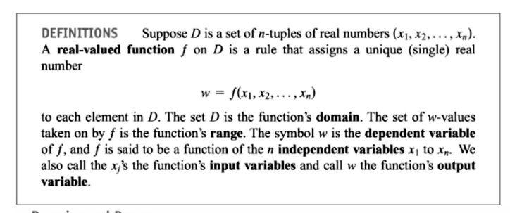
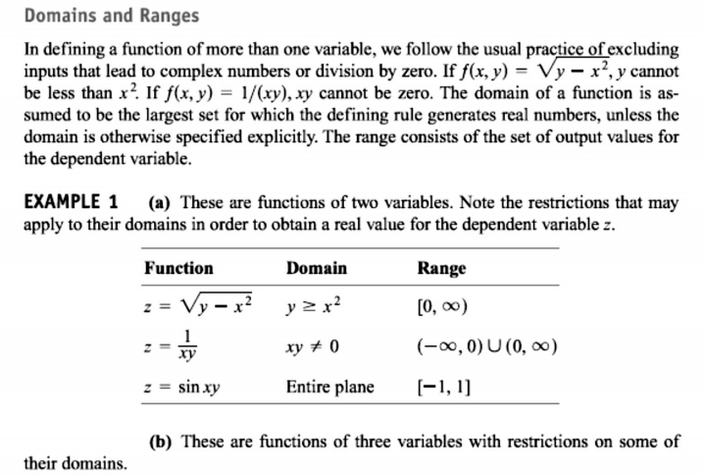
1 / Dep. Of Engineering Mechanics
th
Class: 2 AMTHMATICS / T he Partial Derivatives

Slide 2
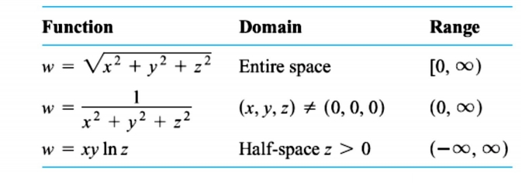
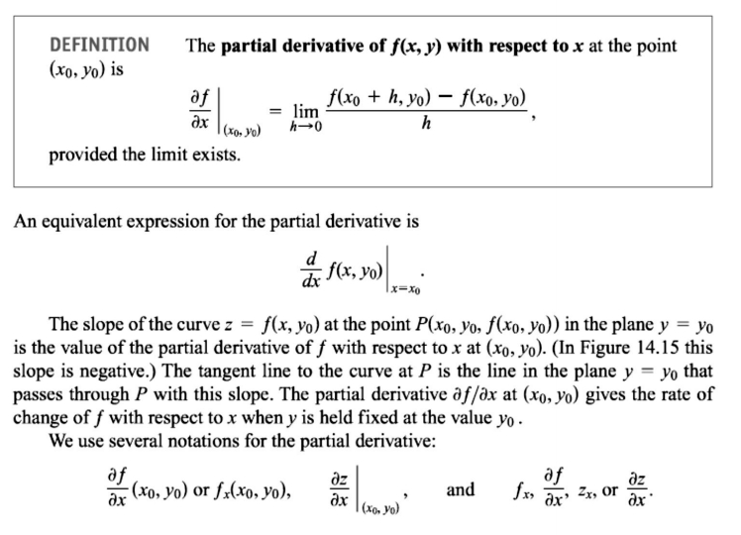
2 / Dep. Of Engineering Mechanics
th
Class: 2 AMTHMATICS / T he Partial Derivatives

Slide 3
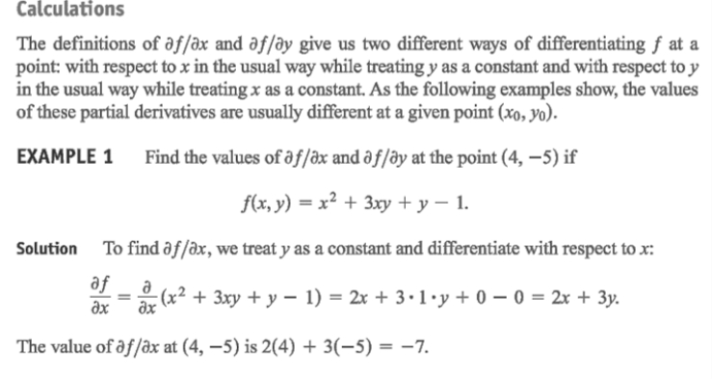
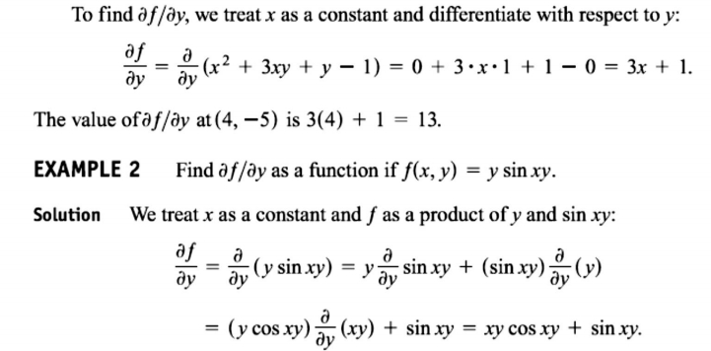
3 / Dep. Of Engineering Mechanics
th
Class: 2 AMTHMATICS / T he Partial Derivatives

Slide 4
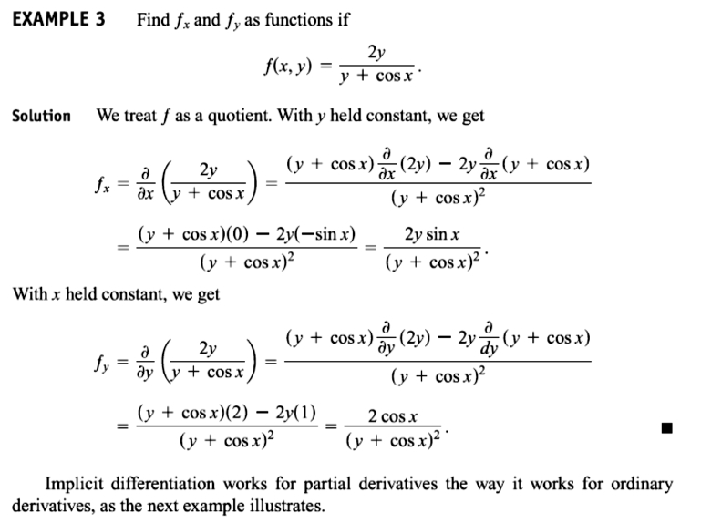
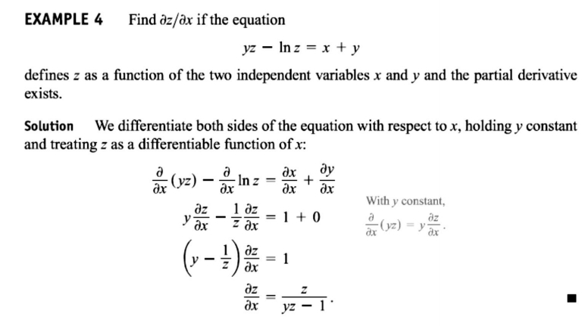
4 / Dep. Of Engineering Mechanics
th
Class: 2 AMTHMATICS / T he Partial Derivatives

Slide 5
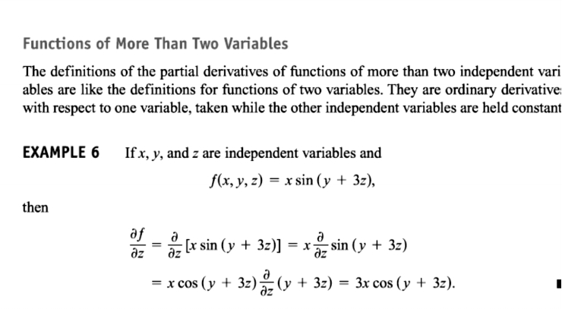
5 / Dep. Of Engineering Mechanics
th
Class: 2 AMTHMATICS / T he Partial Derivatives

Slide 6
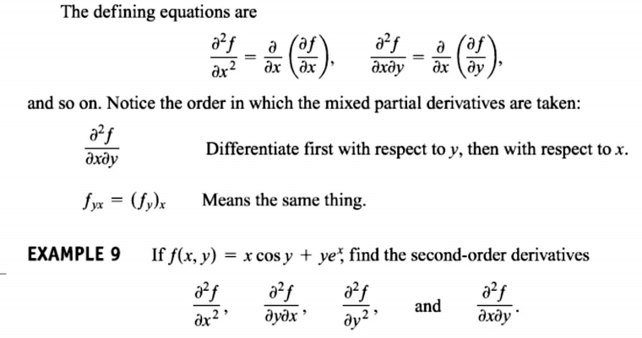
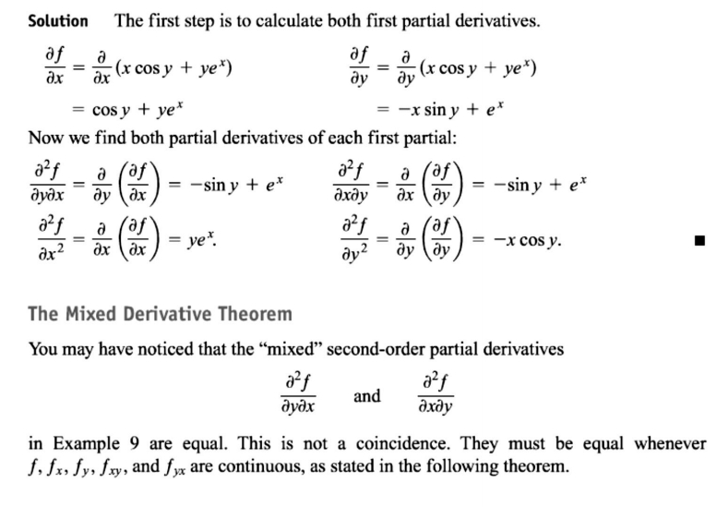
6 / Dep. Of Engineering Mechanics
th
Class: 2 AMTHMATICS / T he Partial Derivatives

Slide 7
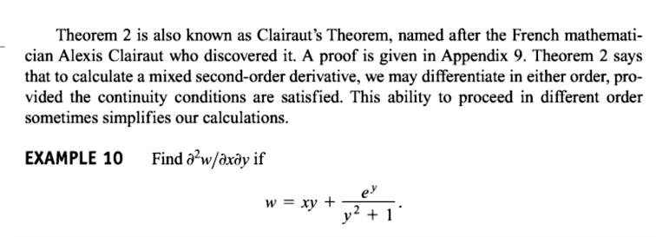
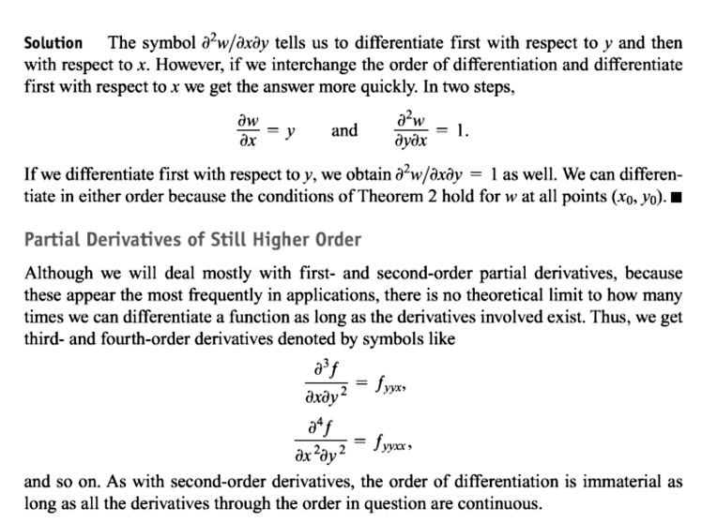
7 / Dep. Of Engineering Mechanics
th
Class: 2 AMTHMATICS / T he Partial Derivatives

